Slide 1


Slide 2
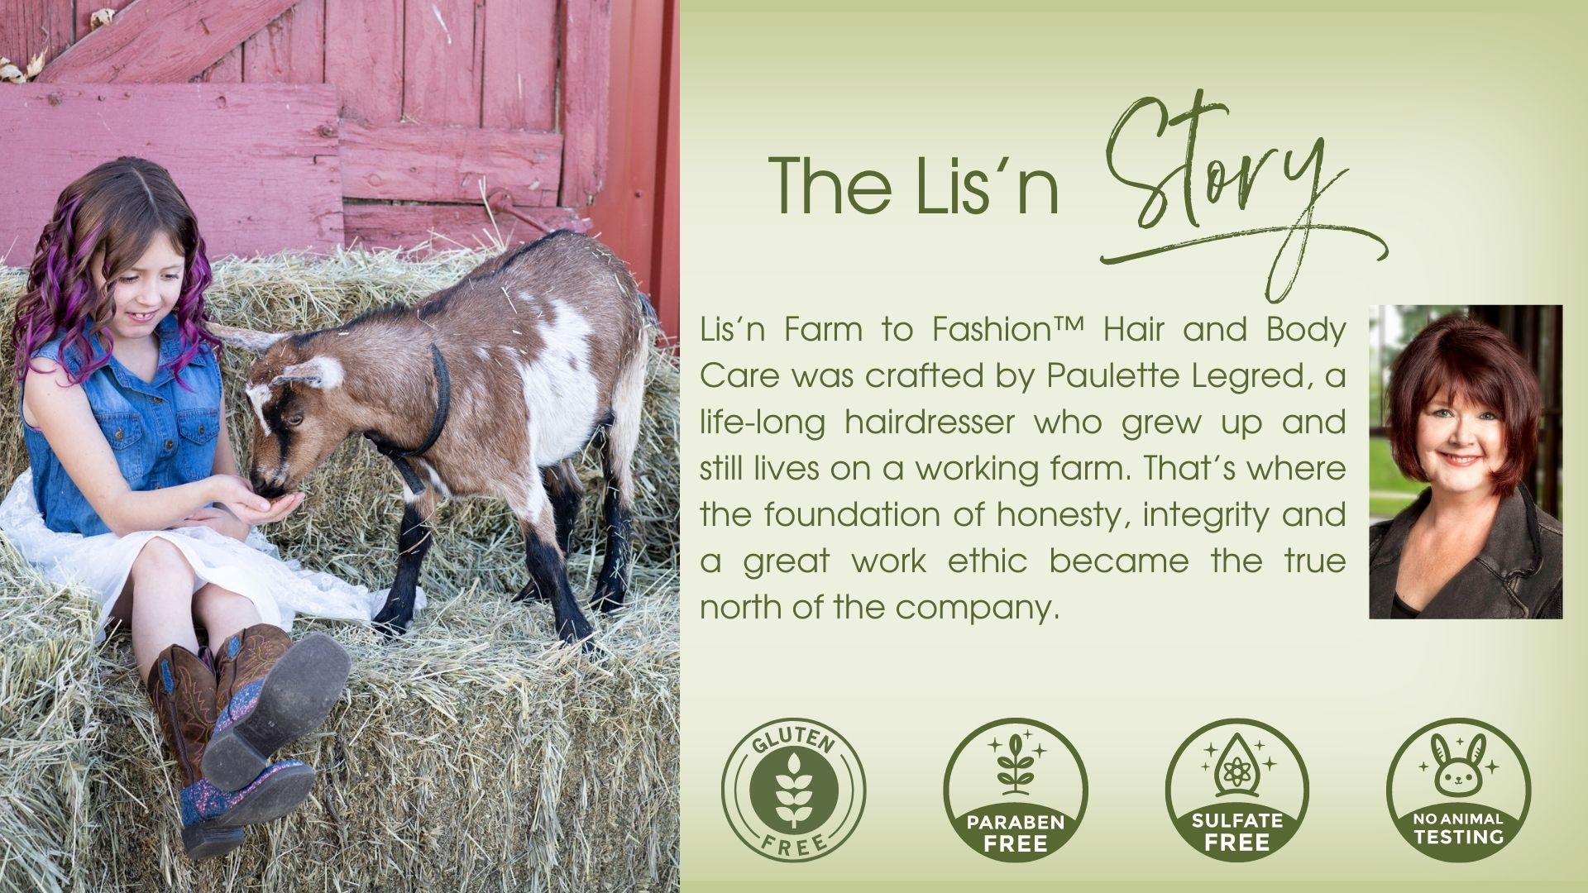

Slide 3

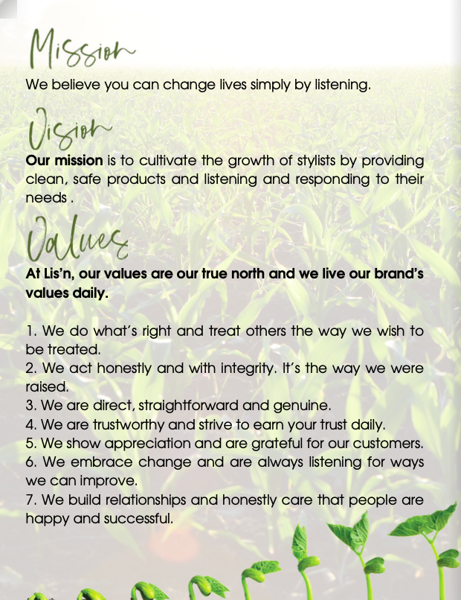

Notes:
Thank you Thank you and welcome to my farm! I really appreciate you coming to help me celebrate the Lis’n 5 year Anniversary! Let’s give a round of applause to the people that made that happen
Kevin beer
Amy VIP of the company Justin, the thinker, idea guy and all around muscle
Dave-- Go to warehouse guy
Anne Sister sales director and attention to detail
Marsha Sales director who knows everyone!
Betty and Julie, warehouse operations. The ones who get it done
Education Team: Nick Caiti, Bethie, Angie, Rudy, Mandy
Speakers: Natalie, and Jeff
(Round of applause_
Gift Bag contents

Slide 4
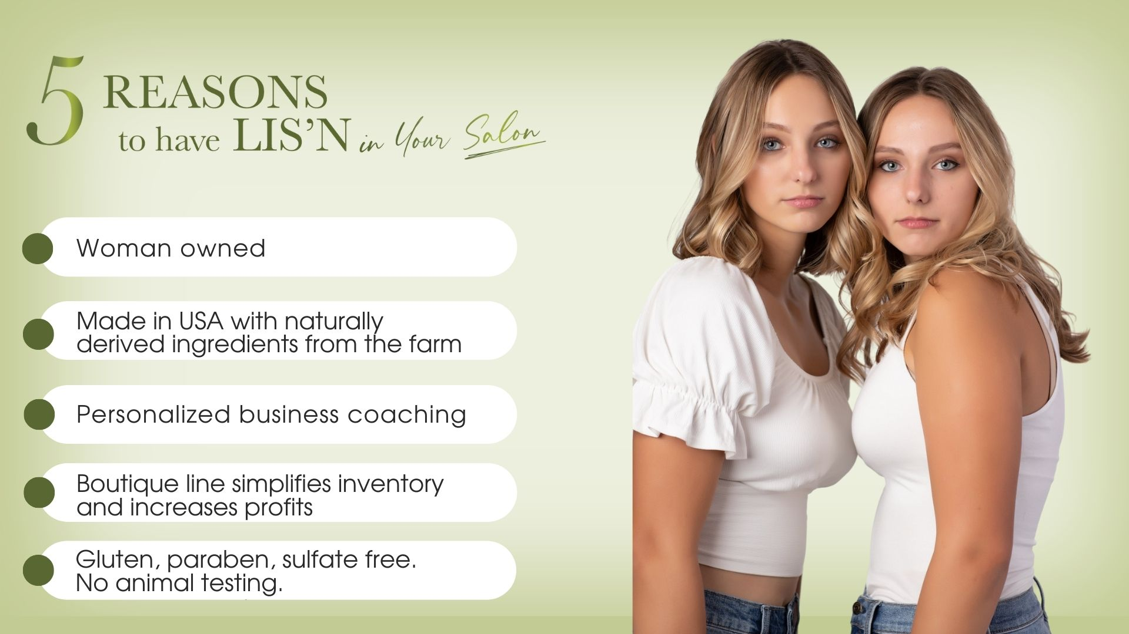

Slide 5


Slide 6

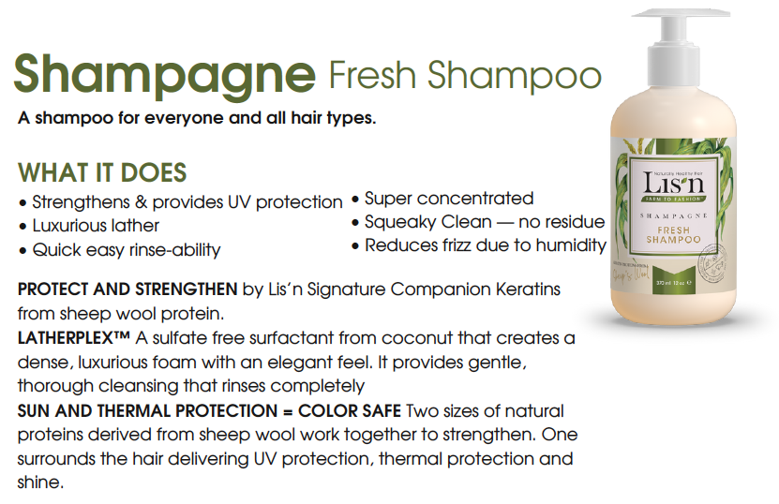

Slide 7


Slide 8


Slide 9
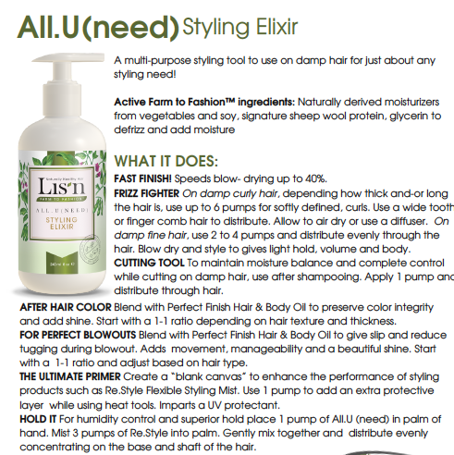

Slide 10
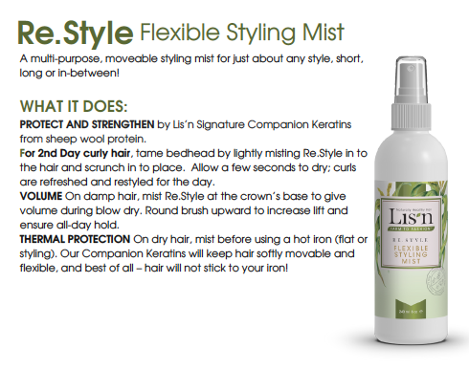

Slide 11
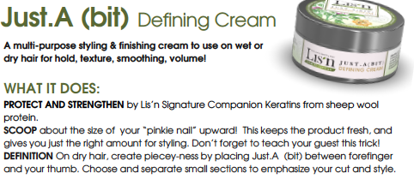

Slide 12
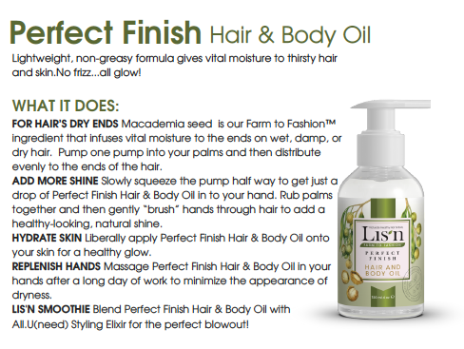

Slide 13
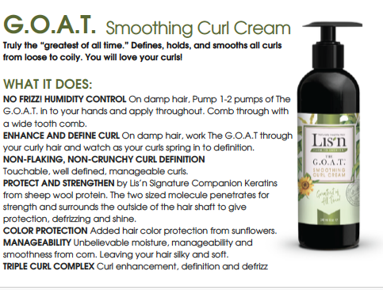

Slide 14
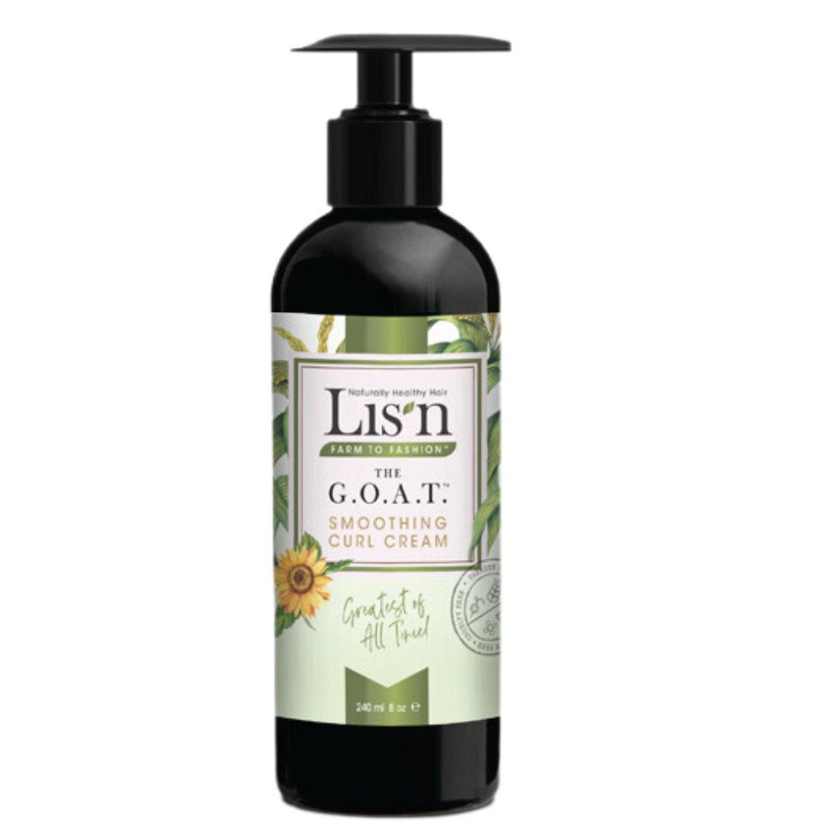
(the) G.O.A.T. Difference
Lis’n Signature Protein
Triple Curl Complex- defines curl, humidity control, adds moisture
Sunflower Seed Extract
NON_STICKY!! Touchable hair!
Not heavy…. All hair types

Slide 15
Lis’n
Blends
Everyone’s hair is different. That’s why we hacked our own product line to personalize products for your guests!

